Slide 1

Counseling Families through Covid-19 Environment
Laurel Kiser, SFCR Developer and PI, FITT Center
Notes:
Sli.do

Slide 2
Learning Objectives
To learn about family adaptations to chronic stress and trauma
To understand telehealth adjustments for work with families during COVID-19

Slide 3
Introductions
Welcome
What would you like to gain from today’s talk?
What is something that you would like us to know about your family? Or the families that you work with.

Slide 4
Family Adaptation to Chronic Stress and Trauma
Model of Complex Adaptations to Trauma in Families
(Kiser, 2015, www.thefittcenter.org)

Slide 5
Family Informed Trauma Treatment (FITT) Model
Child Response
Sibling Relations
Traumatic Context
Individual
and
Family
Outcomes
Family
Unit
Parent-Child Relations
Adult/
Parental
Response
Parenting Practices & Quality
Intergenerational Response
Adult Intimate Relations
Time Acute and longer-term effects
Individual development
Family life cycle
Adapted from Kiser & Black, 2005
Notes:
5
Laurel

Slide 6
Family Risk Models
Families living in traumatic contexts face increased risk for exposure to harsh and unpredictable conditions.
Increased adult distress decreases positive parenting and, in turn, negatively influences family functioning.
Parental and family functioning are associated with outcomes.
Challenges associated with traumatic contexts negatively affect individual functioning by increasing distress.
Notes:
Several theoretical models are critical to understanding the family’s response to chronic stress and traumas including systems theory, ecological and transactional models, and family stress models.
Family risk/protection models explain the connection between contextual factors and adjustment. Multiple models describe how through a series of mediating factors, the strain, stresses, and traumas experienced by individuals influence their well-being. Contextual risks affect everyone involved and these effects are exaggerated through detrimental influences on parental well-being and family functioning.

Slide 7


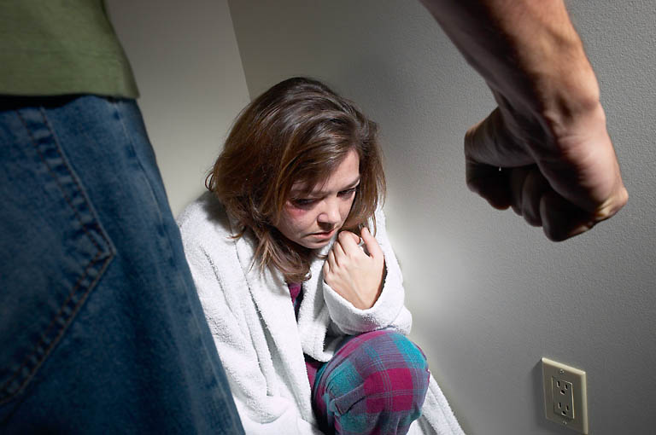
Family Life during COVID
Addictions
Schooling Demands
FINANCIAL INSTABILITY
DAILY HASSLES
DISCRIMINATION
& STIGMA
Negl ect
Loss & Grief
VIOLENCE
RESIDENTIAL INSTABILITY
lsolation

Slide 8
Family Adaptation
to Accumulated Traumatic Circumstances
anxious anticipatory coping style
systemic dysregulations
disturbed relations & supports
altered schemas
disturbances in the family unit
reciprocal distress reactions
individual distress
trauma-related disorders
coping styles & strategies
developmental stage
response dyssynchronies
lapses or declines in the family's ability to serve its basic functions
shifts in needs & relational dynamics
role changes
altered subsystem functioning

Slide 9
Anxious Anticipatory Coping Style
Traumatic Context
Vigilance
Reactivity
Habituation
Avoidance
“anticipatory stress, by its very nature, is a cognitive construct which is ‘learned’”.
[29], p. 9)
Notes:
When trauma is unpredictable or followed by uncertainty about recurrence, families initially tend to react with vigilance. Over time, as uncertainty persists, families shift to anger or to avoidance. Some families remain in a state of hyper-alert and reactivity. Threats immediately and automatically trigger anger or a fight response. Families in this alert state focus on being tough, getting revenge or getting even, and often experience high levels of intra- and extra-familial conflict and violence.
For other families, avoidant coping (escape, distraction or placating) might become the dominant strategy to reduce anticipatory tension. Minimizing and avoidance lead to internalizing of pessimism, futurelessness, lowered expectations, cynicism, hopelessness/helplessness, and a decreased sense of family efficacy (Diehl & Prout, 2002; Hobfoll, Spielberger, Breznitz, & Figley, 1991). At the extreme, avoidant coping can mean no active problem-solving, inaction, and passivity and result in a cessation of family processes (Boss, Beaulieu, Wieling, Turner, & LaCruz, 2003). Families may stop communicating, spending time together, or working collaboratively to get things done.
Families may alternate between anger and avoidance or one becomes the predominant family response. When families alternate between these two responses, interactional patterns may seem unpredictable making it difficult to know how family members will react to any given situation. When one coping strategy predominates, family rules, patterns of interaction, and values may become distorted as this response set becomes ingrained.
High reactivity or avoidance make preventive coping difficult. Families find problem-solving and deliberateness difficult and often family life is characterized by dealing with one crisis after another.

Slide 10
Systemic Dysregulations
Chronic wear and tear
System no longer efficient at responding to the environment.
Alterations in physiological response within the family context
  Attachment, safety, and stress system dysregulations
  Difficulty modulating negative affect with heightened risk for conflict and violence
Notes:
Families serve as regulatory systems by calibrating the responses of individual family members and setting the tone for interpersonal interactions. The process of regulation development for younger family members begins within the dyadic interactions of the caregiver-child subsystem, but this developmental process is shaped by the family's establishment of norms for acceptable affective and behavioral expression.

Slide 11
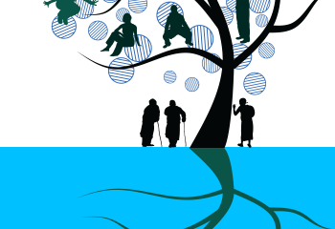
Chronic Disruption to Connectedness
Shifts ANS state.
Distorts social awareness.
Displaces social engagement actions (tend/befriend) with defensive reactions (fight/flight/freeze).
Interferes with healthful reciprocal “co-regulation” of state.
Porges, 2017
This Photo by Unknown Author is licensed under CC BY-SA-NC

Slide 12
Disturbed Relations & Supports
Intra-familial
Extra-familial
Supports
    Compromised family solidarity
    Poor communication channels
    Heightened levels of negativity and conflict
    Decreased relational security
    Family membership transitions or dissolution
    Mistrust
      negative representation of relationships
      suspiciousness
    Heightened levels of negativity and conflict
    Social withdrawal and isolation
      Difficulty identifying resources
      Difficulty asking for or accepting support
      Compromised and burned out support network
      Limited or absent reciprocity
Avoidance of help-seeking
Notes:
[SARAH]

Slide 13
Altered Schemas*
Family schemas become consistent with traumatic exposures
  biased family appraisals and inferencing regarding risk, danger and ability to cope
  rules, beliefs, and world views changed
*May increase individual family members vulnerability to PTSD when exposed to trauma.
(Weingarten, 2004)
Notes:
Unpredictable conditions and recurring traumas shape family schemas. Family schemas are defined as stable, meaningful patterns of organizing information which allow efficient appraisal and response (Dattilio, 2005; Reiss, 1987). Family schemas develop through repeated interaction within the family unit – they shape cognitions, emotions, and behaviors related to family life. They translate into enduring values and views about the way the family understands and interacts with the world. They support the family’s co-creation of meaning by defining beliefs about what is “comprehensible, manageable, and meaningful (Bradley & Corwyn, 2000, p. 352).”
As families try to make sense of life events, they must evaluate them in the context of their shared beliefs and worldview. Uncontrollable traumatic events are often inconsistent with helpful family schemas and when these types of events are catastrophic or occur repeatedly, family schemas end up changing to be more consistent with the traumatic exposures (Patterson, 2002). Repeated violence, victimization, and loss can lead the family to develop schemas around distorted notions and beliefs, such as, the world is dangerous and people are not trustworthy; things usually go wrong for our family and there is nothing that we can do to prevent the bad things from happening; our future will be much like our present with nothing good happening; and, we are not able to deal with the things that happen to us and never will be.
Two consequences of such altered schemas include increasing individual vulnerability to traumatic stress disorders following exposure (Weingarten, 2004) and problems with family meaning making, which can be critical to recovery from trauma.
Negative family schemas create biases or distortions in family appraisal and inferencing which can lead to misattributions of family members’ behaviors. This exacerbates negative reactions and increases the risk of family conflict.
Additionally, as family schemas change in response to chronic traumatic experiences, healthy meaning making processes are impacted. Altered family schemas end up dictating how family members see themselves, each other, and their future. These negative schemas may end up restricting family members’ view of the possibilities of how they can behave or take action in their lives (Dallos, 2004). Continued traumatic experiences reinforce negative schemas and families find it more and more difficult to attach positive meaning to their experiences.

Slide 14
Examples of Altered Schemas
The world is a dangerous place.
People are not trustworthy or dependable.
Things usually go wrong for our family.
There is nothing that we can do to prevent bad things from happening to us.
Our future will be much like our present with nothing good happening.
We are not able to deal with the things that happen to us and never will be.

Slide 15
How does this show up in your work?

Slide 16

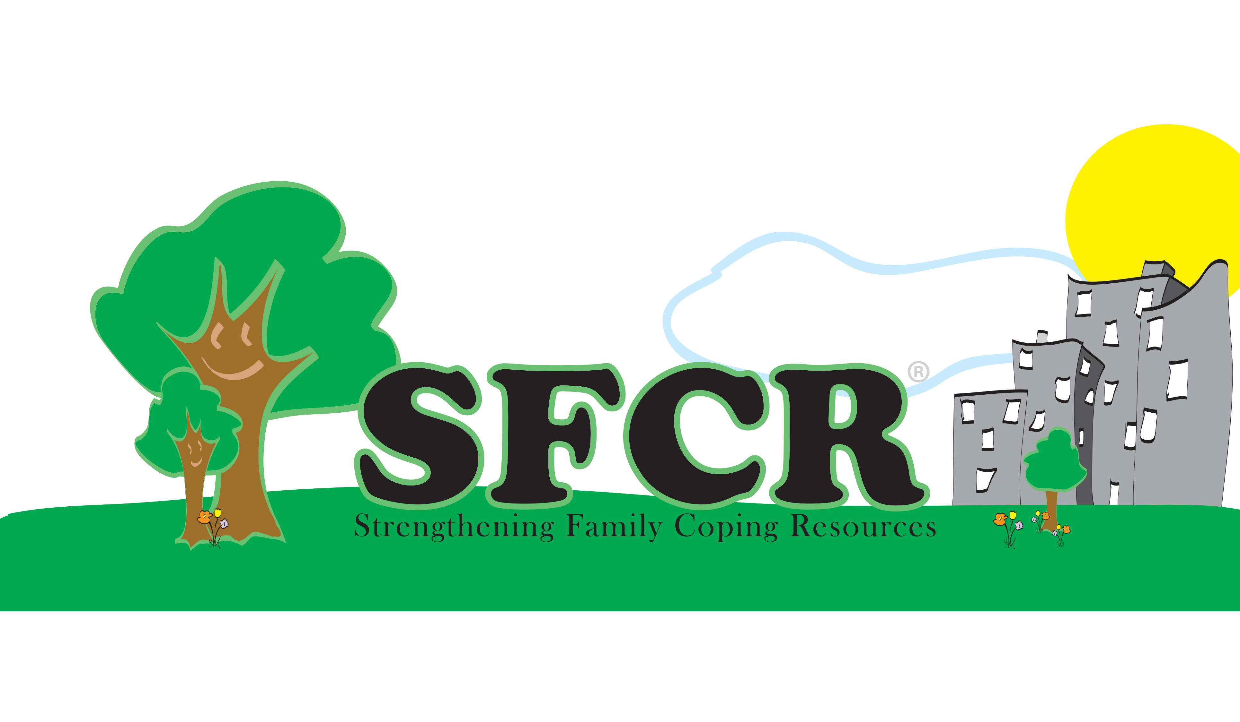
Application of a Family Intervention During COVID-19

Slide 17
Intervention Goals
Decrease the impact of chronic trauma on identified family members.
Increase the protective function of the family by improving constructive coping.

Slide 18
SFCR and the Core
Components of Trauma Treatment
Focus | Components | Links to EBPs
Physiological | Enhancing safety | cognitive therapy, exposure therapy, anxiety management training, mindfulness, kinesthetic activities
 | Stress inoculation skills
 | Exposure with response prevention
 | Mastery
Cognitive | Psychoeducation | cognitive therapy, anxiety management training, evaluation/ reframing of cognitions
 | Cognitive processing
 | Narrative
Behavioral | Behavioral regulation (limits) | anxiety management training, kinesthetic activities
 | Parenting skills
Affective | Affective regulation | anxiety management training, direct exploration of the traumatic experience
 | Narrative
Social | Attachment | support, anxiety management training
 | Narrative
Notes:
SFCR draws heavily on empirically-supported components of effective trauma treatment. These treatment components are delivered in a format that successfully engages all family members in the healing process and simultaneously addresses the pathology that often co-exists in multiple family members. SFCR focuses on physiological, cognitive, behavioral, affective, and social mechanisms that influence the critical symptoms of trauma-related disorder.

Slide 19
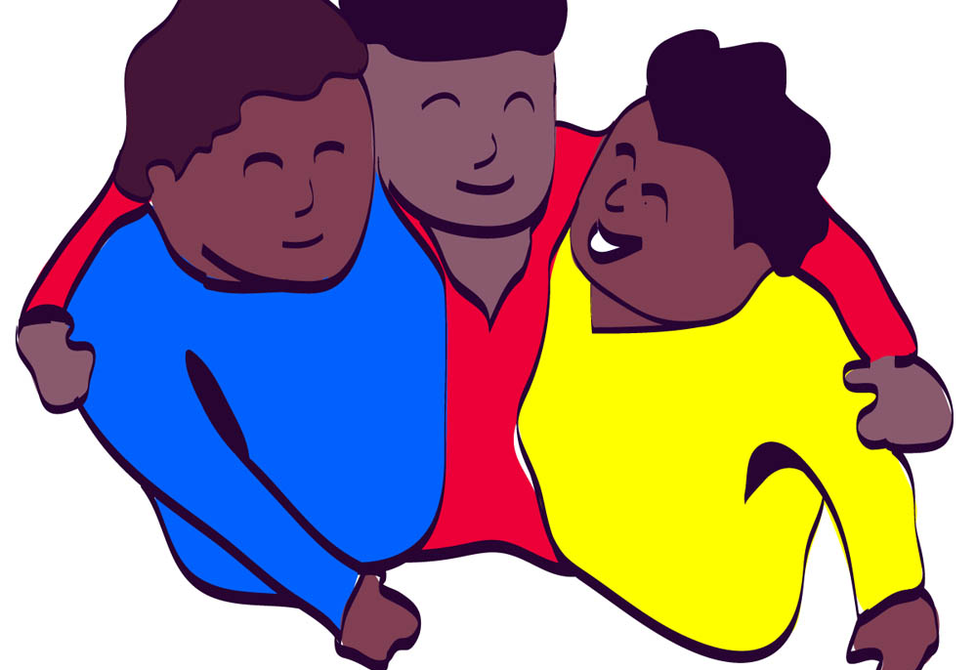
Protective Family Coping Resources
Deliberateness
Structure
Connectedness
Resource Seeking
Co-regulation & Crisis Management
Positive Affect, Memories, & Meaning
Notes:
SFCR links trauma treatment components with family level, coping skills interventions addressing the systemic impact of trauma and the ecological impact of urban poverty. Using a behavioral, skill-building, multi-family group framework, SFCR teaches constructive coping resources to strengthen a family’s protective function potentially vulnerable to chronic exposure to chronic stress and trauma.
Deliberateness: refers to the extent that family members develop and maintain a plan for the family’s life cycle and effectively follow through with their plans. It subsumes the notions of forethought as to the possible course of family life, planning, making life choices, intergenerational transmission, problem-solving, and future orientation.
Structure: entails assuring safety/insulation from danger, rapid stabilization of family functioning, supervision and monitoring, and establishing order and regularity in daily family life. Skill-building activities teach families to effectively use daily routines that help family members understand what to expect by stipulating rules of day-to-day life, define the common set of behaviors acceptable, and meet their safety needs
Connectedness: reflects the degree to which family members feel close to one another, take pleasure in spending time together, share a common value system, and communicate with each other.
Resource Seeking: directed at helping the family identify who they can rely on and increasing the availability of resources they can access when encountering threats to take advantage of the benefits of strong and positive connections with extended kin or close friends following traumatic experience.
Co-regulation: SFCR encourages family coping practices that encourage collective experiences of regulation. Based on social regulation theories. Based on the ABCX family crisis model, families are coached to use a variety of skills/resources to improve the chances that they will have sufficient resources to cope with on-going and new stressors.
Positive Affect: compensatory effects

Slide 20
Practical Applications of SFCR Using TeleHealth
Multi-Family Group Model
Peer-to-Peer Model
4-6 families participate
2-hour weekly sessions
At least two trained facilitators, one technical support facilitator
Break out opportunities by family or age group
Provide materials in different formats
Monetary support and meals for participation
6-10 parents participate
60-90-minute weekly sessions
At least two trained peers lead the group
Break out opportunities for small group or paired discussions
Monetary support for participation
Open or closed group format

Slide 21
Technical Support for Families
Obtaining the right equipment
Accessing the Internet
Setting up the space for participation in group
Attending break out groups
Sharing every family member’s voice
Doing the homework

Slide 22
Family Safety Guidelines for Group
Assessing immediate danger and privacy
Deescalating family conflict
Letting strangers in your home virtually
Mandated reporters
Backup connections during crises or session disruptions

Slide 23
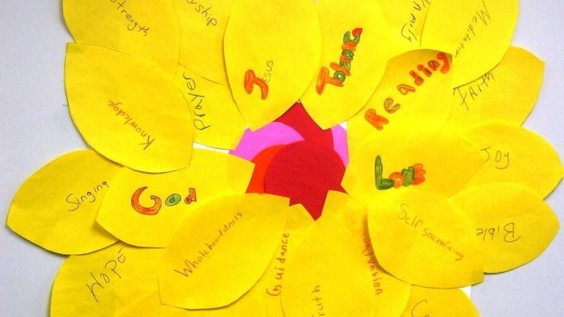
Adapting Activities
Spirituality
Adapted from Working with Groups on Spiritual Themes

Slide 24

For additional information:
  E-mail lkiser@gmail.com
  or visit
  http://www.sfcresources.org/

